Slide 1
intro to python

Slide 2
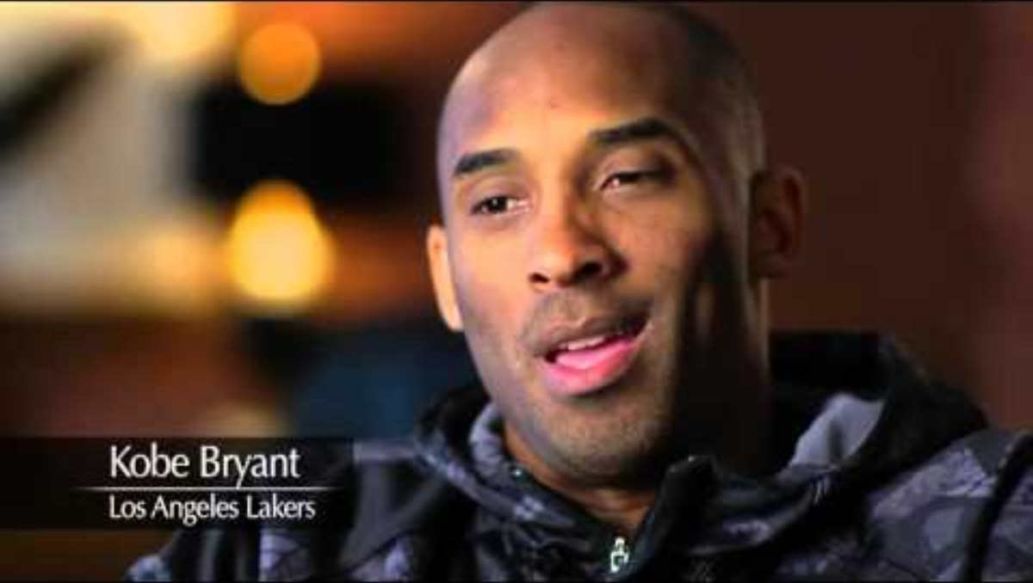
What does kobe Bryant have to do with becoming a software developer?
We will show you the way…
but you have to put in the work
you have to help one another to truly succeed

Slide 3
My teaching philosophy
You are on a journey to become a professional software developer, the expectations are that you work like a professional
At a minimum:
You complete exercises outside of class until you get it right
You practice the concepts presented in class on your own
You recognize things you do not understand and ask questions
If you truly desire to be a professional:
You complete exercises outside of class until you can’t get it wrong
You leverage additional resources to learn more than you are being taught in class
You deeply engage with the material and play with the concepts on your own creatively (write your own applications and use the tools you are being taught).

Slide 4
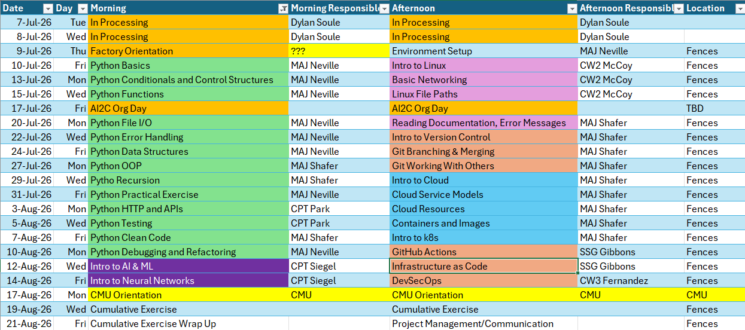
Course Schedule

Slide 5
Before we dive in…
Pull changes from the summer-courses remote repo to your version of the remote repo
Pull those changes locally
Create a notes file in the lesson one folder… I recommend ‘lesson1_notes.py’, commit and push that to your remote repo

Slide 6
What is a Program?
A series of instructions
Executed in order
On a computer
Requires
Computation
Memory / storage
Generally, data is the most important thing
Process
Manipulate
Transform

Slide 7
So what is Python?
High-level, interpreted programming language
simplicity
readability
versatility
Widely used
Professionals, amateurs
Web dev, data science, automation, AI

Slide 8
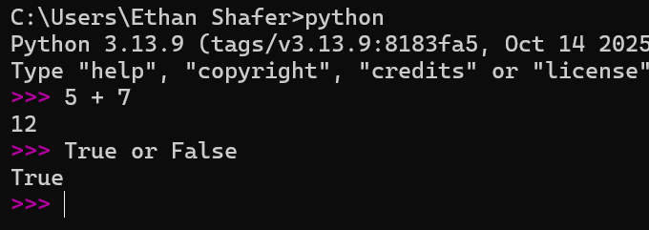
The Interpreter
Go to your terminal and start the python executable
The interpreter runs python code
Lines preceded by ‘>>>’ are instructions
Other lines are results
Expressions evaluate to a specific value
5 + 7 → 12
True or False → False
Statements do not evaluate to a specific value but may have other side effects (more on this later)

Slide 9
Data and datatypes
This is important.
Computers classify data into different datatypes. For instance:
6 is an integer
25.5 is a floating point number (float)
“Hello” is a string
True is a boolean
Python will interact with different datatypes differently.
Give examples of the following primitive datatypes:
Integers
Floats
Strings
Boolean

Slide 10
Spot the Difference
01100011011011110110111101101100
01100011011011110110111101101100
01100011011011110110111101101100
1,668,247,404 (int)
4.4168006258522776e+21 (float)
"cool" (string)
Notes:
binary_demo.py

Slide 11
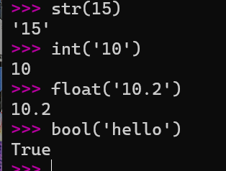
Data Type Conversion (Casting)
There are predefined functions we can use to explicitly convert data from one type to another:
int()
float()
str()
bool()
Notes:
Age1 = “18”
Age2 = “19”
Sum_of_ages = age1 + age2
Print(sum_of_ages) --🡪 1819
Let’s say I want to use how old you will be in 4 years.
Num = int(age1) + int(age2)
Print(num) --🡪 37
Print(type(num1))
Age1 = int(age1) <<< now age1 is an integer because we overwrote it.

Slide 12
Operators
Arithmetic
Code | Meaning
x + y | Addition
x + y | Concatenation
x - y | Subtraction
x * y | Multiplication
x / y | Division
x // y | Integer/floor division
x % y | Modulo (remainder)
-x | Negation
x ** y | Exponentiation
Reference: https://docs.python.org/3/library/stdtypes.html

Slide 13
Operators
Assignment
x += 1
is equivalent to
x = x + 1
and other assignment operators are similar.
Code | Meaning
x = 3 | Assignment
x += 3 | Add and assign
x -= 4 | Subtract and assign
x *= 5 | Multiply and assign
x /= 3 | Divide and assign
x //= 3 | Floor divide and assign
x % = 7 | Modulo and assign

Slide 14
Operators
Comparison
Logical
Code | Meaning
x < y | Less than
x > y | Greater than
x == y | Equal to
x <= y | Less than or equal to
x >= y | Greater than or equal to
x != y | Not equal to
Code | Meaning
x or y | True if either is true
x and y | True only if both are true
not x | True if x is false
Reference: https://docs.python.org/3/library/stdtypes.html

Slide 15
Order of Operations
The order of operations in Python is essentially the same as in math you are already familiar with:
PEMDAS
Expressions in parentheses
Exponentiation
Multiplication, division, integer division, and modulo (remainder)
Addition and subtraction
Operators with the same precedence (except for **) are evaluated from left-to-right. (In algebra we say they are left-associative.)
(15 – 5) * 10 + 7
15 – 5 * 10 + 7
15 - 50 + 7
-35 + 7
-28
10 * 10 + 7
100 + 7
107
Notes:
PEMDAS
Please Excuse My Dear Aunt Sally
Parentheses, Exponent, Multiply/Divide, Add/Subtract

Slide 16
In Class Exercise 1
Run the following code snippets in the interpreter. What do they do?
How do we fix the last one?
10 + 15
"10" + "15"
10 + "15"

Slide 17
Variables

Slide 18
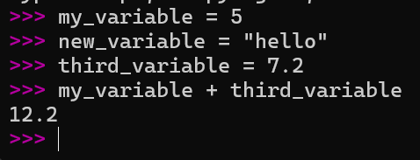
Variables
Name | Memory Addr | Type | Value
my_variable | 0x00000000
new_variable | 0x00000001
third_variable | 0x00000006
int
string
float
5
“hello”
7.2
Variables are stored in memory
Can be read
Can be written
Can be deleted
Used for short-term storage
Given the snippet from below, let’s fill in the table on the right…
How does the computer calculate the value for the last line?

Slide 19
Wait a minute…
What was the result of the first line?
Is that a statement or an expression?
Important! Statements do not give a value back.
Expressions do evaluate to a value.
Statements can contain expressions

Slide 20
Variable Naming Rules
You can name a variable anything but…
cannot start with a number.
cannot have any spaces
can include an underscore (_)
cannot include other special characters (&*^%!)
cannot be a python keyword (for, if, else…) (You’ll learn more keywords as you learn the language)
can be the same name as a predefined Python function, but this will remove functionality from the language

Slide 21
Variable Naming Rules and Conventions
Variable Assignment | Is Allowed?
magic_number = 10
aReallyLongButOkayVariable = “Acceptable?”
123Pianos = 123
for = 25
print = 100
Yes
Yes
No
No
Yes, but you will no longer be able to use the print() function

Slide 22
Variable Naming Conventions
Your variable name should…
describe something about the data
use_snake_case_for_variables
UseCapWordsForClassNames
Use ALLCAPs for constants

Slide 23
In Class Exercise 2
A Pittsburgh pizza shop is having a two-for-one deal. You can get two small (12”) pizzas for $9.99. In contrast, a large pizza (17”) costs $9.99. Which one is the better deal (yields more area)?
What is your first intuition?
With a partner, write a plan on how to solve the problem
Then write Python code in the interpreter to answer this question.
Use variables to store data for later
Use 3.14 for pi
area = pi * radius ** 2

Slide 24
Take a Break

Slide 25
Python Scripts

Slide 26
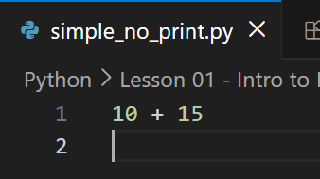
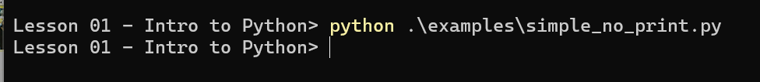
Scripting
A python script is a text file
By convention, filename ends with .py
Contains a series of python statements
When executed, runs all statements, in-order
Statements are not shown like the interpreter
Expressions are not shown like the interpreter
Use print() function to display values to the terminal
Run with `python <path_to_script>`

Slide 27
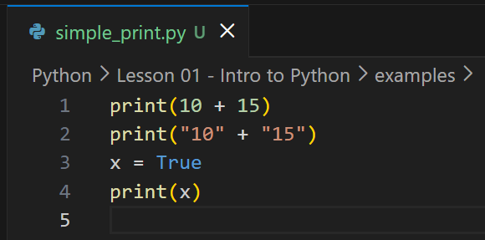
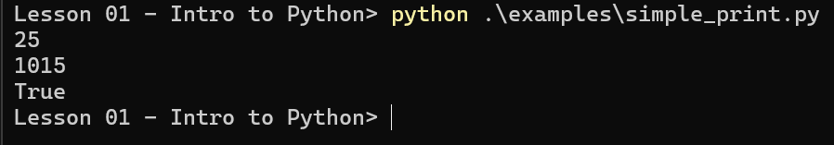
Another Example

Slide 28
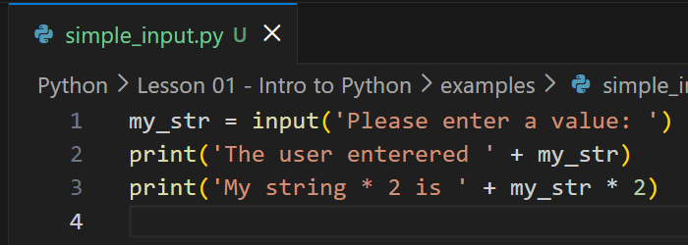
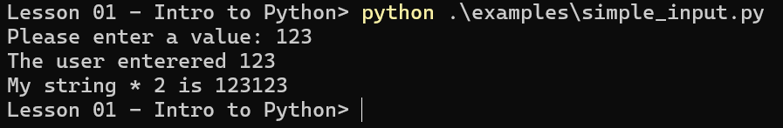
Interacting With Scripts – Input()
The input() function waits for the user to type something and hit enter
Always gives you a string back

Slide 29
In Class Exercise 3 – SIMPLE INPUT
Write a Python Script that:
Asks the user for their name
Asks the user for their favorite number
Prints “Hello” and then their name
Prints “Your favorite number is” and then their favorite number
Prints “Your favorite number minus 10 is” their favorite number minus 10

Slide 30
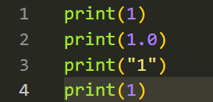
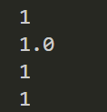
MORE INFORMATION ABOUT THE PRINT FUNCTION
What datatypes can it accept?
What do you notice about the output on the right?

Slide 31
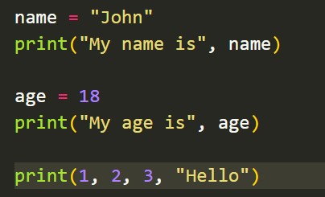

MORE INFORMATION ABOUT THE PRINT FUNCTION
Can print multiple statements, separated by a comma.
What do you notice about the output on the right?

Slide 32
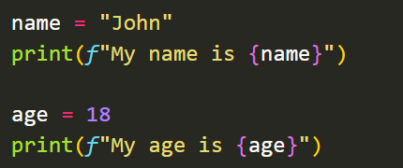
F- Strings in python (formatted string
Very powerful. Learn to use f strings. (You’re a professional”)
What do you notice about the output on the right?

Slide 33
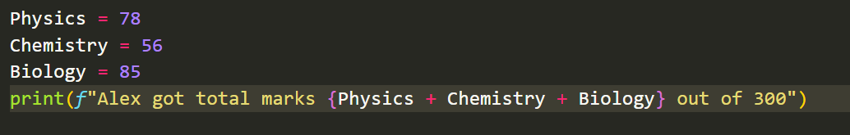
Why F-Strings?
Allows you to embed variables and expressions directly inside of your print statements

Slide 34
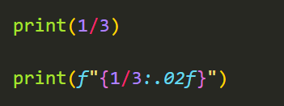

Why F-Strings?
Allows you to apply formatters to determine how many decimal points to print, and much more!

Slide 35
In Class Exercise 4 – Pizza pizza
Write a script that prompts the user for a diameter of the pizza and outputs the area
Remember to convert from string to another datatype
Stretch goal #1: write a script that calculates the price per area. The user should input the diameter and the cost.
Stretch goal #2: write a script that calculates the best deal.
The deal is 2 pizzas of one size compared to 1 pizza of another size. The user should input two diameters (one for the first deal, one for the second deal), and the two costs.
Solutions available in the lesson folder

Slide 36
RECAP
What is Python?
What are some data types in Python?
How do we interactively run the Python Interpreter?
How do we run a python script?
What is the order of operations in Python?
What if expressions have the same precedence in PEMDAS?
How do we get text input from a user?
What datatype does the input() function return?

Slide 37
Questions

